Slide 1
Privacy-Preserving Federated Learning for Distributed Skin Disease Classification
Alex Gu
Supervised by Ruihong Qiu and Zi (Helen) Huang

Slide 2
Contents
01 | Motivation
02 | Background & Methods
03 | Knowledge Gap
04 | Project Aim
05 | Progress
06 | Next Steps & Conclusion

Slide 3
Definitions and Background
01

Slide 4
Definitions
Federated Learning
    Training a shared model across distributed data without centralising the data
Non-IID
    Not independent and identically distributed data
    Data is distributed differently across nodes
      Data does not come from the same probability distribution

Slide 5
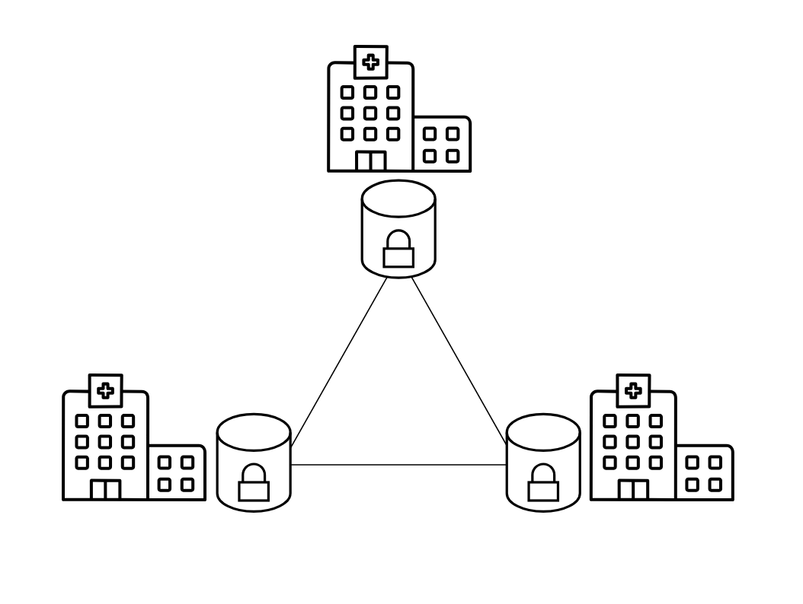
Motivation
Skin diseases are among the most prevalent health conditions globally [1].
Deep learning can classify dermatologist level [2] but generalisation requires diverse data across skin tones, imaging hardware and patient demographics.
In practice, this data sits in separate health institutions. HIPAA and GDPR restrict centralisation, so a single institution rarely holds enough data to train a robust classifier.
Notes:
Health Insurance Portability and Accountability Act (HIPAA)
General Data Protection Regulation

Slide 6
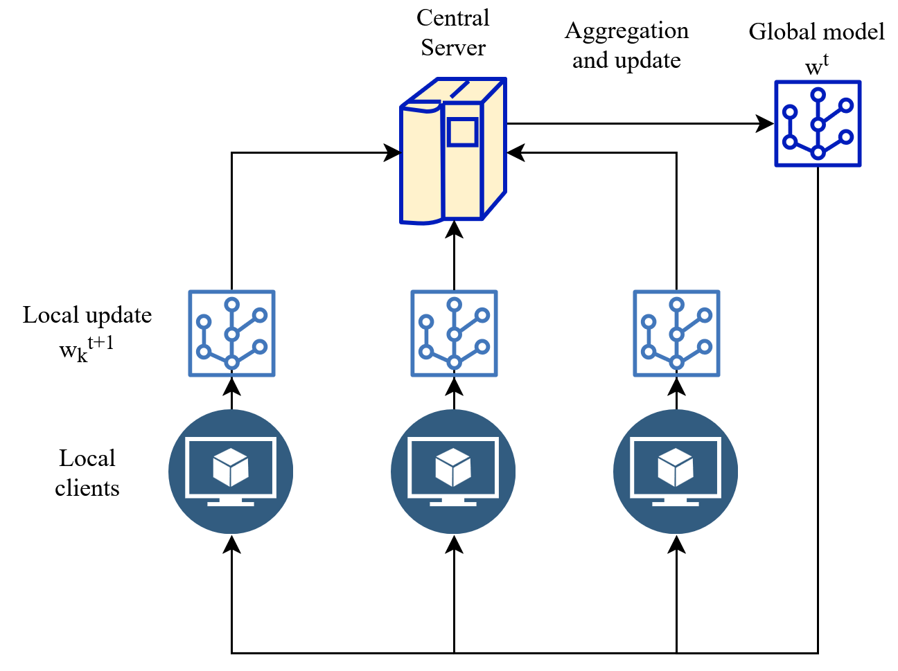
FedAvg
Federated Averaging (FedAvg) trains a shared model across distributed clients without exchanging raw data [3].
Multiple local epochs before each averaging step reduce communication compared to gradient-level methods.
Convergence is not guaranteed when client data is non-IID.

Slide 7
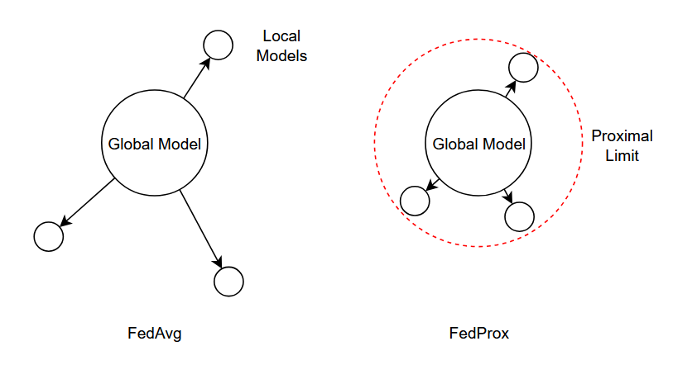
The Non-IID Problem
Different client distributions cause local models to drift apart
What it means
Each client’s data is drawn from a different distribution
Common forms: label skew, quantity skew, feature skew
Why FedAvg struggles
Local SGD pulls each model toward a different optimum
Averaging divergent updates can make divergence worse
No mechanism limits how far local models drift
FedAvg drift (left) vs FedProx constraint (right)
Proximal term (μ-weighted) penalises deviation from the global model
and gives convergence guarantees [4]

Slide 8
Knowledge Gap
Federated learning on multi-class skin disease classification
    Most medical FL work targets binary or few-class radiology and pathology tasks; fine-grained skin disease classification is not well studied
FedAvg vs FedProx under realistic non-IID conditions
    Direct comparisons on medical image data with realistic class imbalance and label skew remain scarce
Practical trade-offs
    Existing studies report accuracy but rarely evaluate communication cost and per-class performance alongside non-IID sensitivity

Slide 9
Project Aim
Three questions this thesis is structured to answer
Where does FedProx beat FedAvg, and by how much?
    Dirichlet α from extreme skew to near-IID; measure where the proximal term actually pays off
What does federated learning cost?
    Communication rounds and parameter volume to reach centralised baseline accuracy
Where does federated learning fail first?
    Whether overall accuracy or minority-class performance degrades earlier under heterogeneity

Slide 10
Progress
02

Slide 11
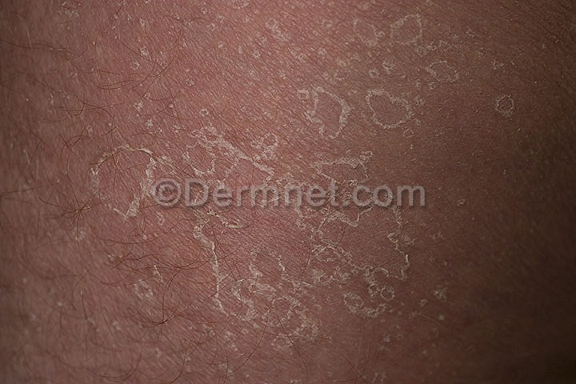
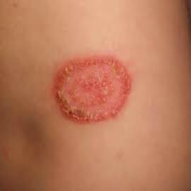
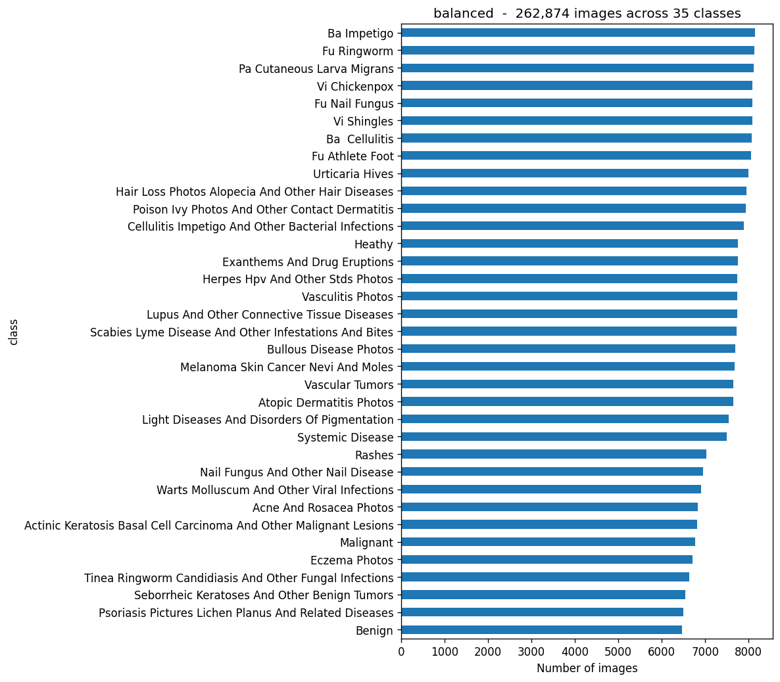
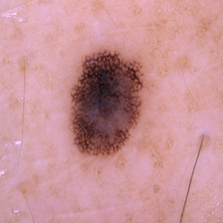
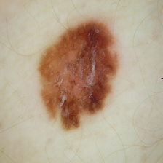
Progress: Datasets & Sampling
Sample Images
Balanced: 263k images / 35 classes (sampled to 17.5k) [5]
[5] muhammadabdulsami, "Massive Skin Disease Balanced Dataset", Kaggle

Slide 12
Progress: Centralised Baseline
Working pipeline; first baseline trained on the balanced sample
SETUP
ResNet on the balanced sample
17,500 images / 35 classes
10 epochs
TEST RESULTS
57.6%
Top-1 accuracy
Macro F1: 0.569
Test loss: 1.44
CONTEXT
~20× random (1/35 = 2.9%)
In line with literature for 30+ class fine-grained skin tasks (50–65%)
Next: Dirichlet sampling, FedAvg

Slide 13
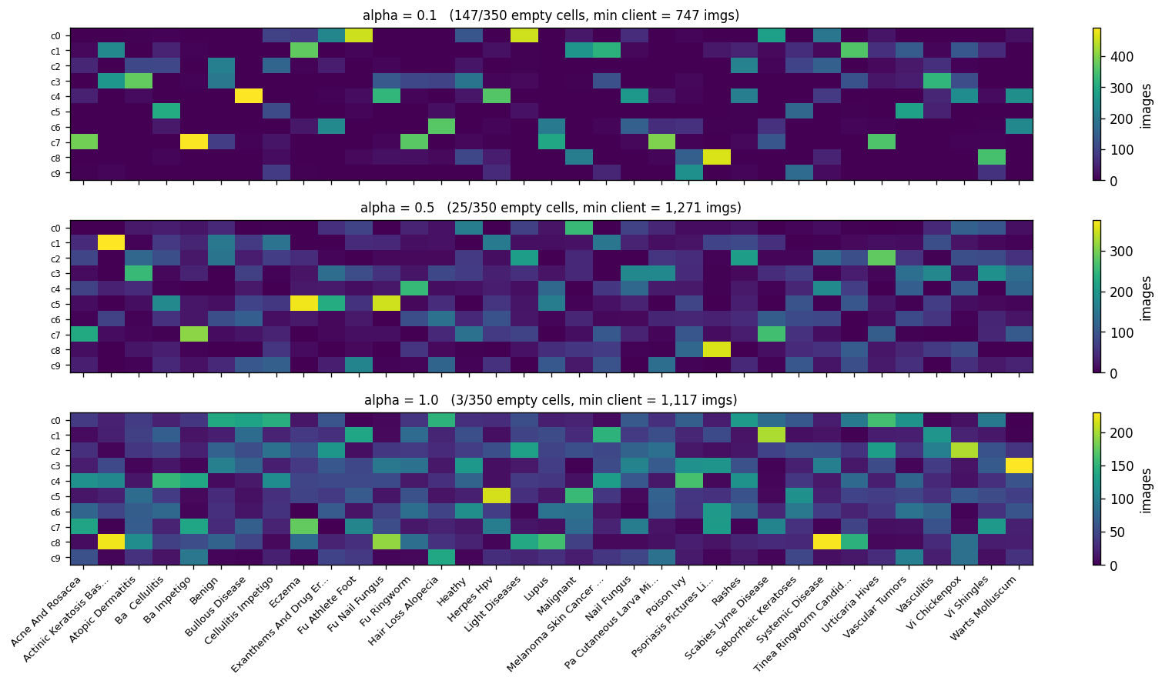
Progress: Dirichlet Sampling [6]
α = 0.1 — extreme skew
122 / 280 cells empty; smallest client 334 imgs
α = 0.5 — realistic skew
12 / 280 cells empty; smallest client 1,678 imgs
α = 1.0 — near-IID
4 / 280 cells empty; smallest client 1,645 imgs
[6] Hsu, Qi, Brown, arXiv 2019

Slide 14
Next Steps
01
02
03
04
Baseline
FedAvg
FedProx
Evaluation
Re-run on full datasets, longer training; locks the upper bound for FL comparisons
Local SGD + weighted parameter aggregation across 8 simulated clients; first run at α = 1.0
Add proximal term; sweep α = 0.1, 0.5, 1.0 for both methods; tune μ
Accuracy + macro F1 + communication rounds vs α; multiple seeds for statistical confidence

Slide 15
Conclusion
By the end of Semester 2:
An answer to where FedProx beats FedAvg, by how much, and at what communication cost for fine-grained skin disease classification under realistic non-IID conditions
Questions?
Multi-class skin disease classification across hospitals is privacy-constrained; FedAvg breaks under non-IID, FedProx is proposed
Both datasets characterised; sampling pipeline preserves class structure within 0.4%
Centralised baseline running end-to-end; Dirichlet partitioning validated across α = 0.1, 0.5, 1.0

Slide 16
References
[1] R. J. Hay, N. E. Johns, H. C. Williams, I. W. Bolliger, R. P. Dellavalle, D. J. Margolis, R. Marks, L. Naldi, M. A. Weinstock, S. K. Wulf, C. Michaud, C. J L Murray, and M. Naghavi, “The global burden of skin disease in 2010: An analysis of the prevalence and impact of skin conditions,” The Journal of Investigative Dermatology, vol. 134, pp. 1527–1534, June 2014
[2] A. Esteva, B. Kuprel, R. A. Novoa, J. Ko, S. M. Swetter, H. M. Blau, and S. Thrun, “Dermatologist-level classification of skin cancer with deep neural networks,” Nature, vol. 542, pp. 115–118, Feb. 2017.
[3] H. B. McMahan, E. Moore, D. Ramage, S. Hampson, and B. A. y Ar cas, “Communication-Efficient Learning of Deep Networks from Decentralized Data,” Jan. 2023.
[4] T. Li, A. K. Sahu, M. Zaheer, M. Sanjabi, A. Talwalkar, and V. Smith, “Fed erated Optimization in Heterogeneous Networks,” Apr. 2020.
[5] “Massive skin disease balanced dataset.” https://www.kaggle.com/ datasets/muhammadabdulsami/massive-skin-disease-balanced-dataset
[6] T.-M. H. Hsu, H. Qi, and M. Brown, “Measuring the Effects of Non-Identical Data Distribution for Federated Visual Classification,” Sept. 2019

